Slide 1
SMART HELMET FOR AGRICULTURE
Under the guidance of
Dr. Prabaharan S.R.S
BY
Group ID: G_14
Chava Sai Teja -13BCE1032
Chunduri Asritha Chowdary – 13BEC1042
Valeti Lalitha - 13BEC1160

Slide 2
Objective
Detecting the weeds in the crop through the webcam mounted on the helmet.
Processing the taken images using image processing technique.
Depending on the area of weed we calculate the amount of pesticide to be sprayed to the effected crop.
This calculated amount of pesticide to be sprayed is send to automatic sprayer which is present in the field through RF module in the form of a trigger.

Slide 3
Introduction
In olden days weed detection was done by employing some men especially for that purpose. They will detect the weed by checking each and every place of the field. Then they will pluck them out manually using their hands.
Later with the advancement in the technology they started using the herbicides to remove the weeds. But to detect the weeds they are still using manual power in many parts of the world.
Later there came few methods to detect the weeds automatically but due to lack of their accuracy they are unable to reach to the people. Then they started using image processing for this purpose.

Slide 4
In this project our main aim is to detect the weed in the crop by using image processing.
Then we will give the inputs of the weed areas to an automatic spray pesticide only in those areas.
For this we need to take a photograph of the field with good clarity to detect the weeds with more accuracy. Taking a photograph can be done by attaching a camera helmet.
Then we will apply image processing to that image to detect the weed.

Slide 5
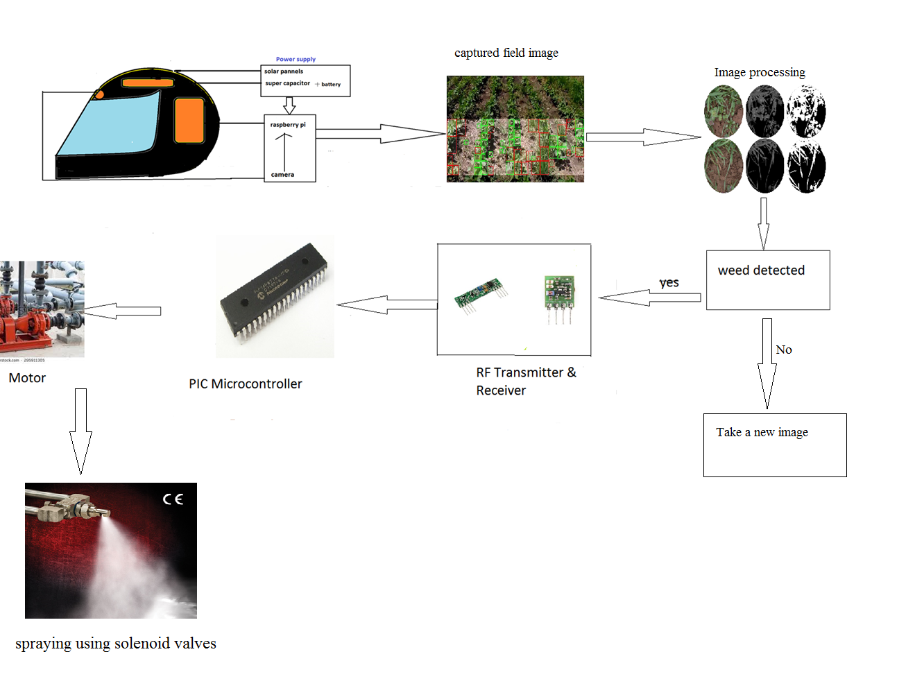
Block diagram

Slide 6
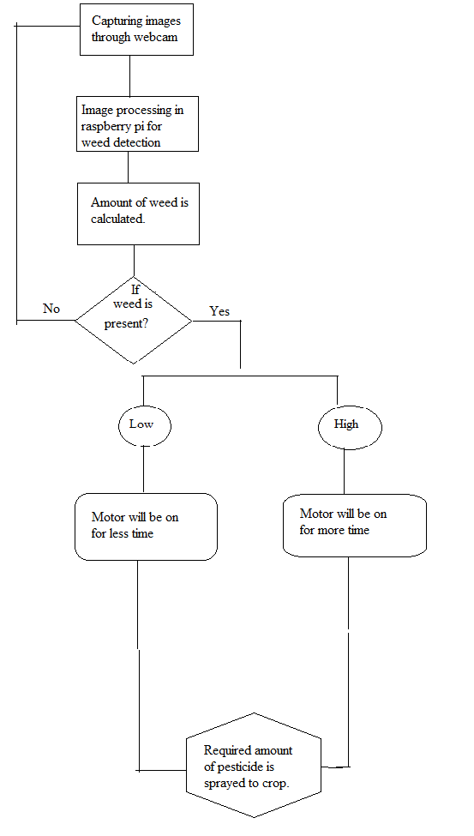
Flow chart

Slide 7
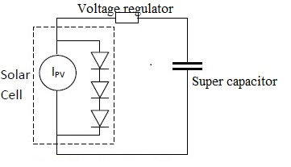
Modules –explanation with design
Weed detection part(using Image processing)
Here the camera through which crop images are taken is connected to raspberry pi in which image processing is done. Webcam is connected through USB cable to one of the USB port of raspberry pi.
Power supply for raspberry pi
Power supply for raspberry pi

Slide 8
The energy harvester is like a hose with an endless supply of water filling a barrel, which is analogous to a super capacitor. If the hose is still running once the barrel is full, the water may overflow. This situation differs from that of a battery, which has a limited energy supply and thus would require a series regulator.
Power supply in spraying part
It consists of a transformer which has its primary winding connected to the mains supply. A secondary winding, electro-magnetically coupled but electrically isolated from the primary is used to obtain an AC voltage of suitable magnitude and it drives the circuit to the rectifier which converts the AC power supply to the DC power supply. Here the rectifier circuit used is the bridge rectifier. Here two diodes in series conducts at any one time .The main advantage is that the diodes requires only half the reverse break down voltage

Slide 9
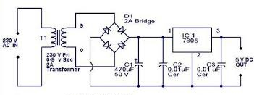
The rectifier is followed by a filter to convert to dc and finally the 12v dc supply is sent in to a voltage regulator .Here the 7805 voltage regulator is used to provide a fixed voltage of 5V to the microcontroller.
Power supply for Microcontroller

Slide 10
Data transmission
For transmitting data from raspberry pi to PIC microcontroller we will be using RF transmitter and receiver.
RF TX-434: The transmitter output is up to 8mW at 433.92MHz with a range of approximately 100 foot (open area) outdoors. Indoors, the range is approximately 50 foot, and will go through most walls. It accepts both linear and digital inputs, can operate from 1.5 to 12 Volts-DC
RF RX-434: The receiver also operates at 433.92MHz, and has a sensitivity of 3uV. The RWS-434 receiver operates from 4.5 to 5.5 volts-DC, and has both linear and digital outputs.

Slide 11
Standards
Wi-Fi
The Raspberry Pi 3 is equipped with 2.4 GHz Wi-Fi.
IEEE standard is 802.11n (150 Mbit/s).
RF transmitter
The transmitter output is up to 8mW at 433.92MHz with a range of approximately 100 foot (open area) outdoors. Indoors, the range is approximately 50 foot, and will go through most walls.
RF receiver
The receiver also operates at 433.92MHz, and has a sensitivity of 3uV. The RWS-434 receiver operates from 4.5 to 5.5 volts-DC
USB
IEEE 1394 is an interface standard for a serial bus for high-speed communications and isochronous real-time data transfer.

Slide 12
Real time constraints
Constraint 1:
For showing the design as a prototype the webcam and the RF module that were chosen are meant only for a smaller range and smaller distances. Hence this system cannot be implemented directly in the fields. But the same idea can be used for the real time implementation.
Alternative
As an alternative high resolution camera, more efficient power supply can be used.
Tradeoff
Cost will be more for implementing the above mentioned alternative.

Slide 13
Constraint 2:
As of know we are using Canny edge detection algorithm combined with color segmentation for detecting the weed based on the criterion of part with color other than green as weed. Hence, if weed is of green color it will not be identified.
Alternative
Depending on edge frequency of different kinds of weed we need to differentiate between weed and normal plant. Thus above mentioned problem is solved.
Tradeoff
For each kind of crop there will be different edge frequencies for normal crop and weed. So it will be difficult to design a overall algorithm for weed detection in different crops.

Slide 14
Constraint 3:
Here, in our weed detection code color segmentation only with white background and green leaf and respective threshold values is implemented. So if the background coloris changed then the output will not be as desired.
Alternative
The threshold values need to accordingly changed based on the background color whenever there is change in the implementation environment.
Tradeoff
It will be time consuming process to change the threshold values for every change in the implementation surrounding.

Slide 15
Constraint 4:
Solar panels and super capacitor are used as power supply which will not meet the power requirement for raspberry pi.
Alternative
So we need to use a 12v battery paralleled with solar panels as power supply for raspberry pi.
Tradeoff
12v battery is over weighing to be inserted in the helmet as the farmer can carry it only when he is stationary. And also it gives power supply for just 30mins to 1hr that we use.

Slide 16
Results
Images of crop are taken from webcam and are processed in raspberry pi.
Implementation of weed detection algorithm for processing crop images.
Amount of weed in the crop is calculated.
From calculated weed amount the time for which motor should be on to spray a particular amount of pesticide to crop is set.
Thus a particular amount of pesticide is sprayed for respective weed quantities.
Other than image processing part the main aspect of system is power supply to the raspberry pi through solar panels, super capacitor and battery which is the most efficient way of power supply.

Slide 17
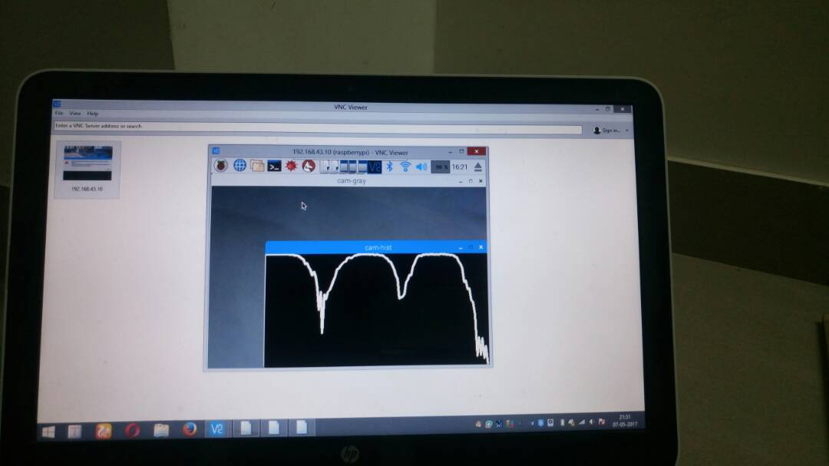
Histogram of captured image

Slide 18
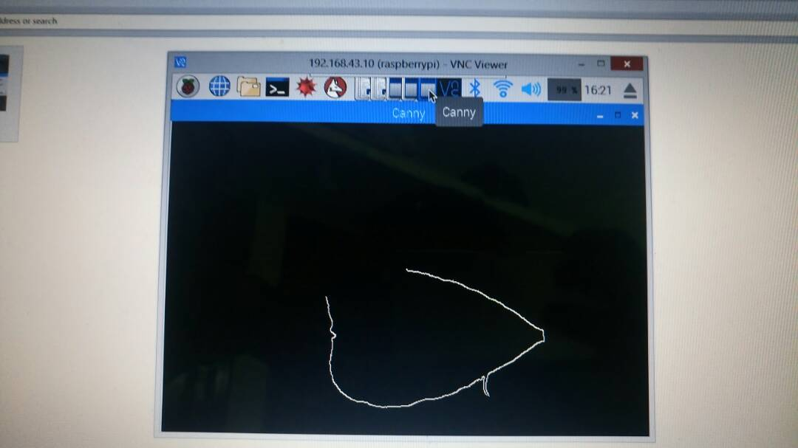
Edge detection of captured leaf image

Slide 19
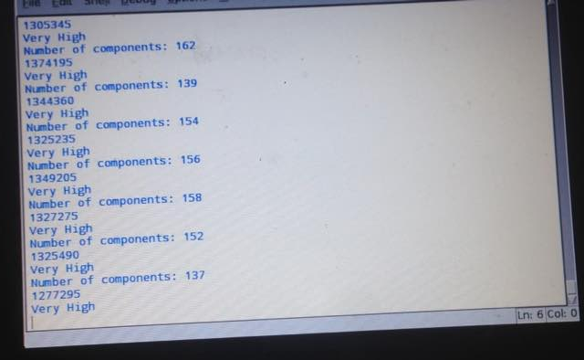
Calculating quantity of weed

Slide 20
Conclusion
In this project we have developed a method by which we can detect the weed using image processing. The input of the detected weed area is given to the automatic sprayer which sprays only in the weed area. By doing so we can reduce the usage of pesticides, thus saving the environment. And also we are using helmet as a protection to the farmer from sun and also as a platform for power supply using solar panels mounted on it.

Slide 21
Question ?

